Slide 1

Landslide Susceptibility Mapping along the Silchar-Shillong Highway in Northeast India Using LSI Technique
CE 594: Geohazard Science and Engineering
Under The Guidance of Dr. Rishikesh Bharti (Assistant Professor)
Presented By:
Pranjul Sahu(234104006)

Slide 2
Content of the Study
Introduction
Study Area
Geological setup of the region
Data collection
Methodology
Results
Discussion and Conclusion
References

Slide 3
Introduction
Landslides are found as most risky natural event, causing high number of losses of lives and huge impact on neighbourhood infrastructure in all over the world.
In general, landslides are caused by combination of geo environmental factors.
Landslides are triggered by many extrinsic causative factors such as rainfall, earthquake, blasting and drilling, cloudburst, flash-floods etc.
Mountainous regions are heavily affected by means of the natural catastrophe of landslides. Like other devastating natural hazards, landslides are vital environmental failures which results damage and destruction to infrastructure, gardens, grasslands and agricultural fields.

Slide 4
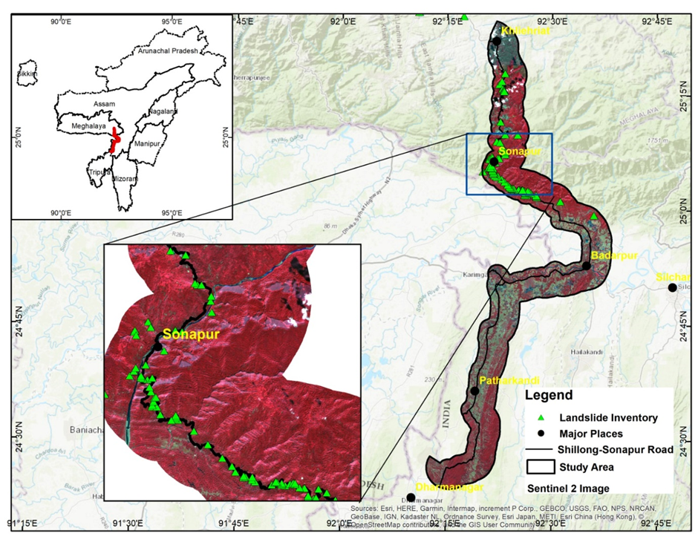
Study Area
The study area consisted of 5 km width corridor along Silchar-Shillong highway, geographically bound by 25" 0' 0" N to 25° 15' 00" N latitudes, 92° 20' 0" E to 92° 30' 00" E longitudes.
It covers approximately 200 sq.km along 50 km of national highway with 5 km corridor falling in parts of Jaintia Hills of Meghalaya as well as parts of Assam.
The area is mostly covered by thick forest and experiences heavy monsoon rainfall during May to September causing landslides along the Highway, the most spectacular being the Sonapur landslide at the centre of the study area.

Slide 5
Geological setup of the region
The study area principally consists of three zones, which arc characterized by distinct geology and physiographic set up.
The southern areas up to the base of the Jaintia hills consist of mainly rocks of Surma Group and form undulating terrain and low-lying hills.
The areas north of this unit extending beyond Sonapur till Dauki Fault consist of mainly Barail Group of rocks forming high hills and steep ridges.
The areas beyond Dauki fault consist of mainly plateau forming limestones and sandstones of Sheila formation belonging to Jaintia Group (Das et al., 2001).

Slide 6
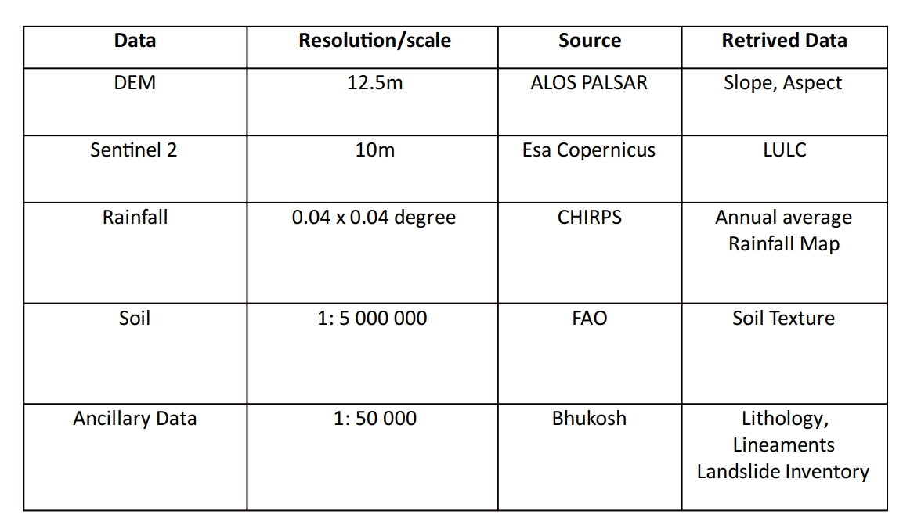
Dataset collection:
To accomplish the objective of the study, eight potential landslide factors are utilized for LSM preparation (Fig 2 a, b, c, d, e, f, g, h, e). All the factors along with their source, data type and resolution are provided in Table1
Table 1: Thematic layers used for multi-criteria analysis

Slide 7
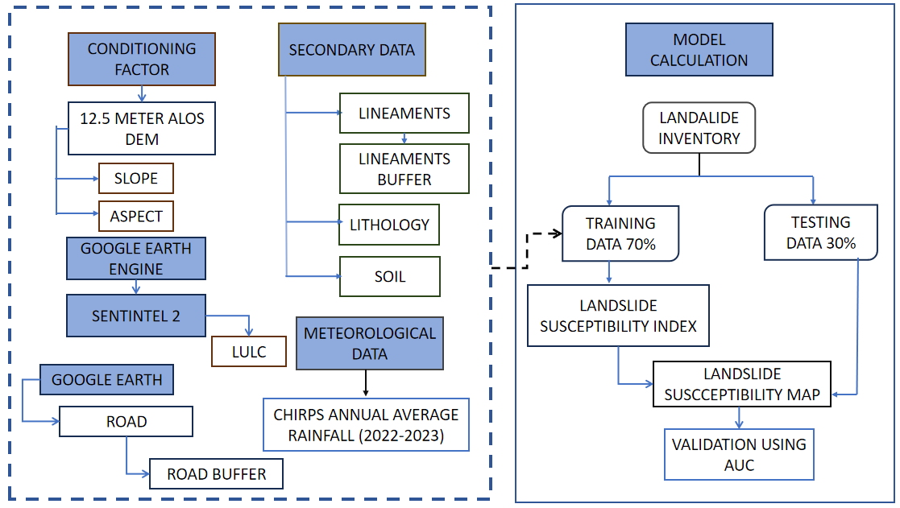
Flowchart:
Fig.3. Flowchart of proposed methodology

Slide 8
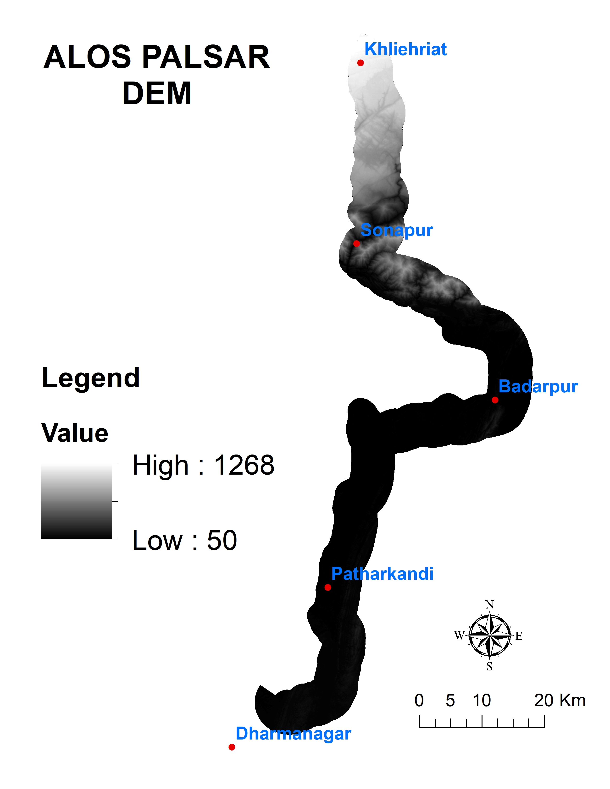
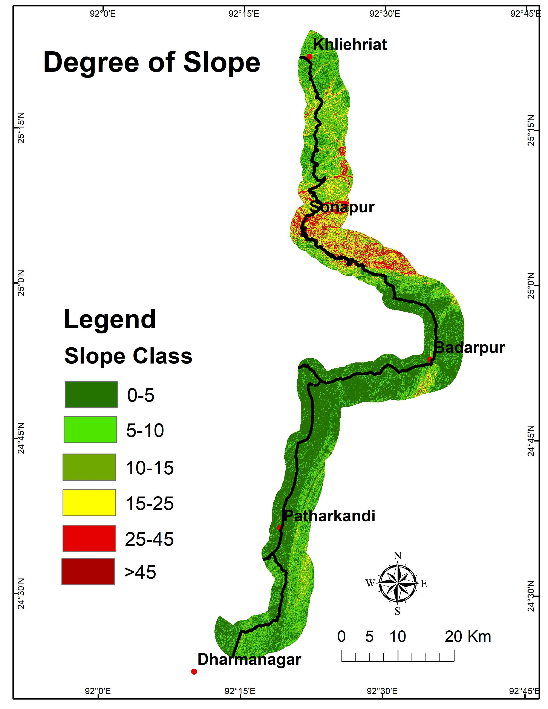
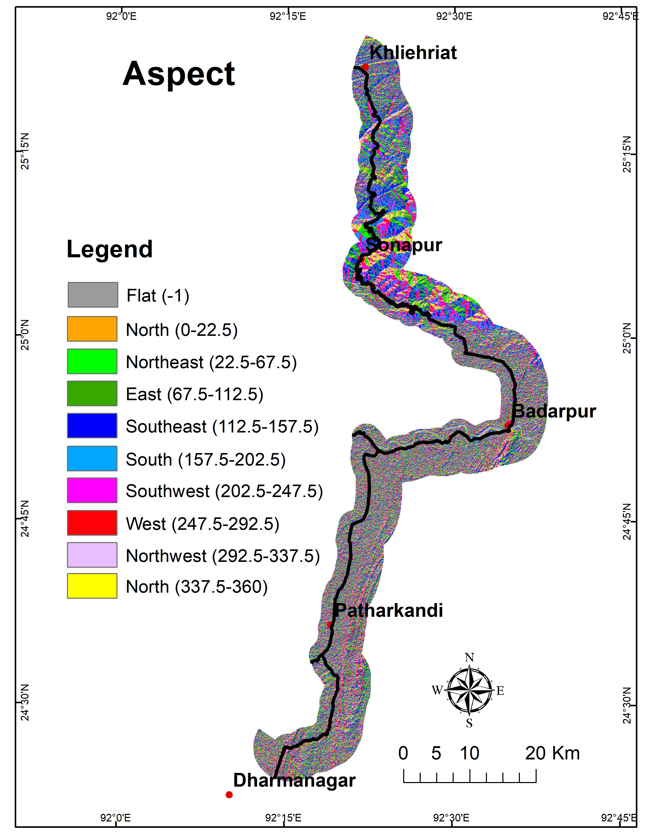
Criteria Layers:

Slide 9
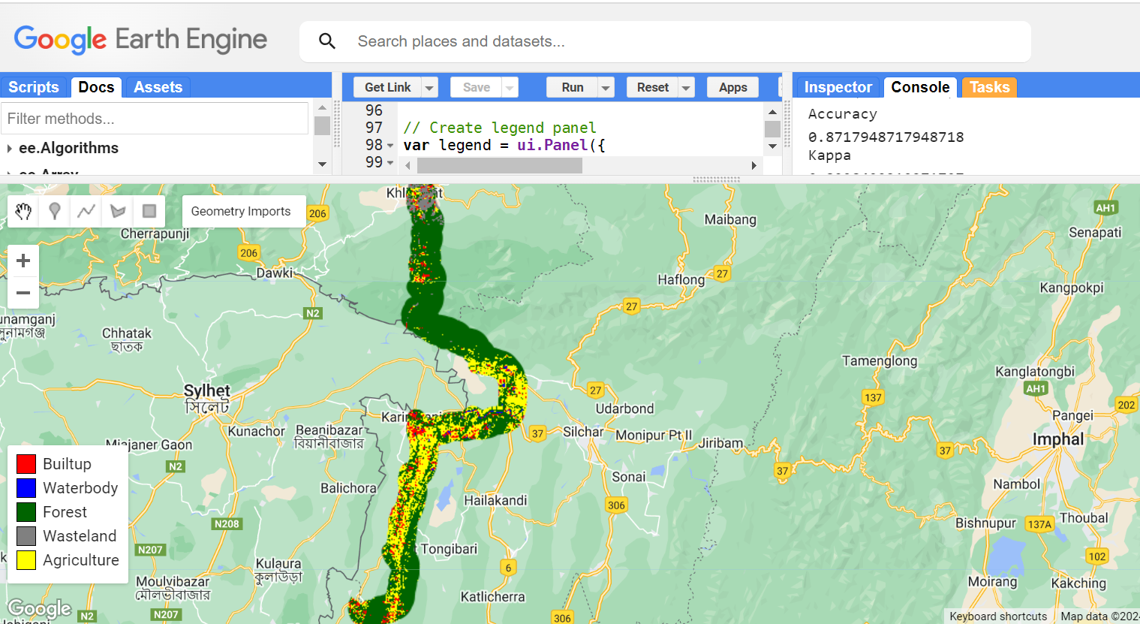
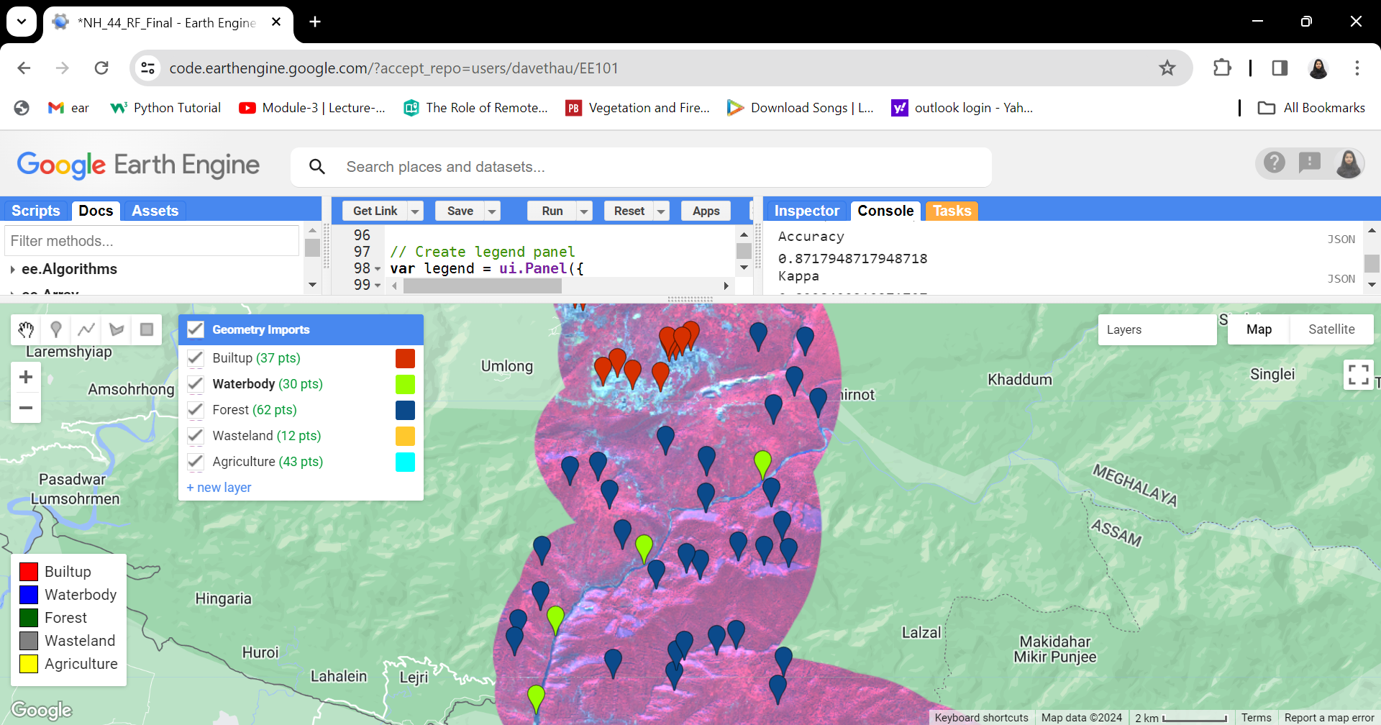
LULC USING RANDOM FOREST CLASSIFIER

Slide 10
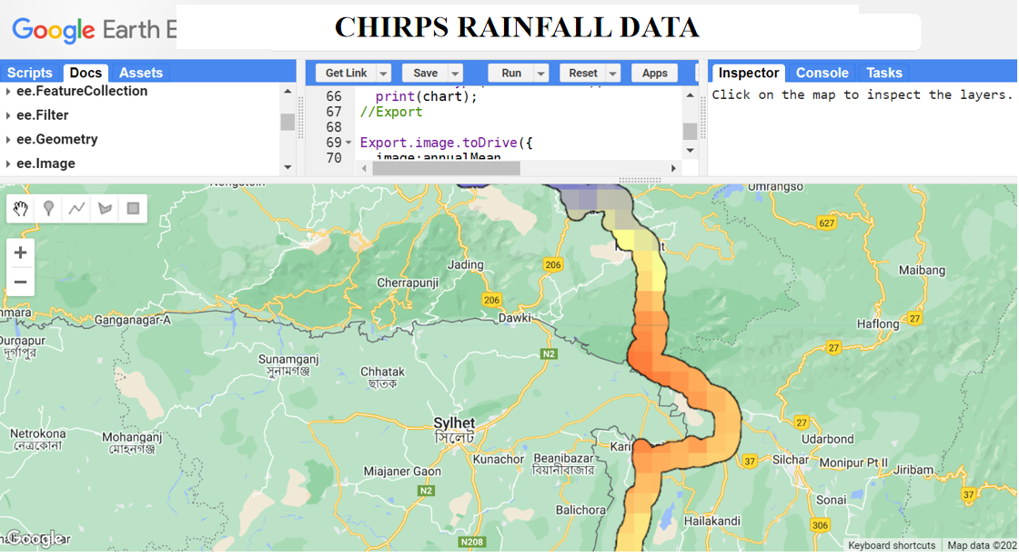

Slide 11
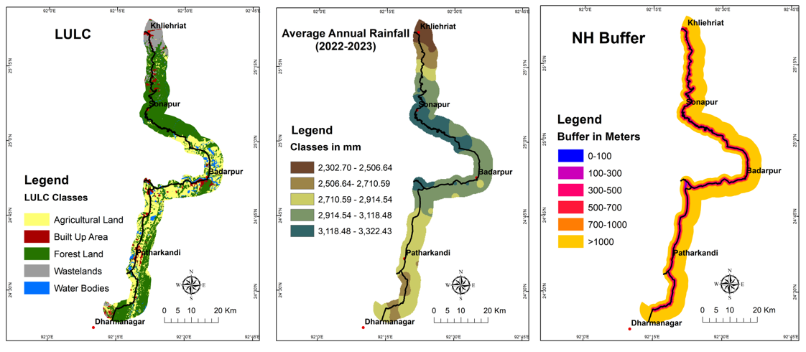
Criteria Layers:

Slide 12
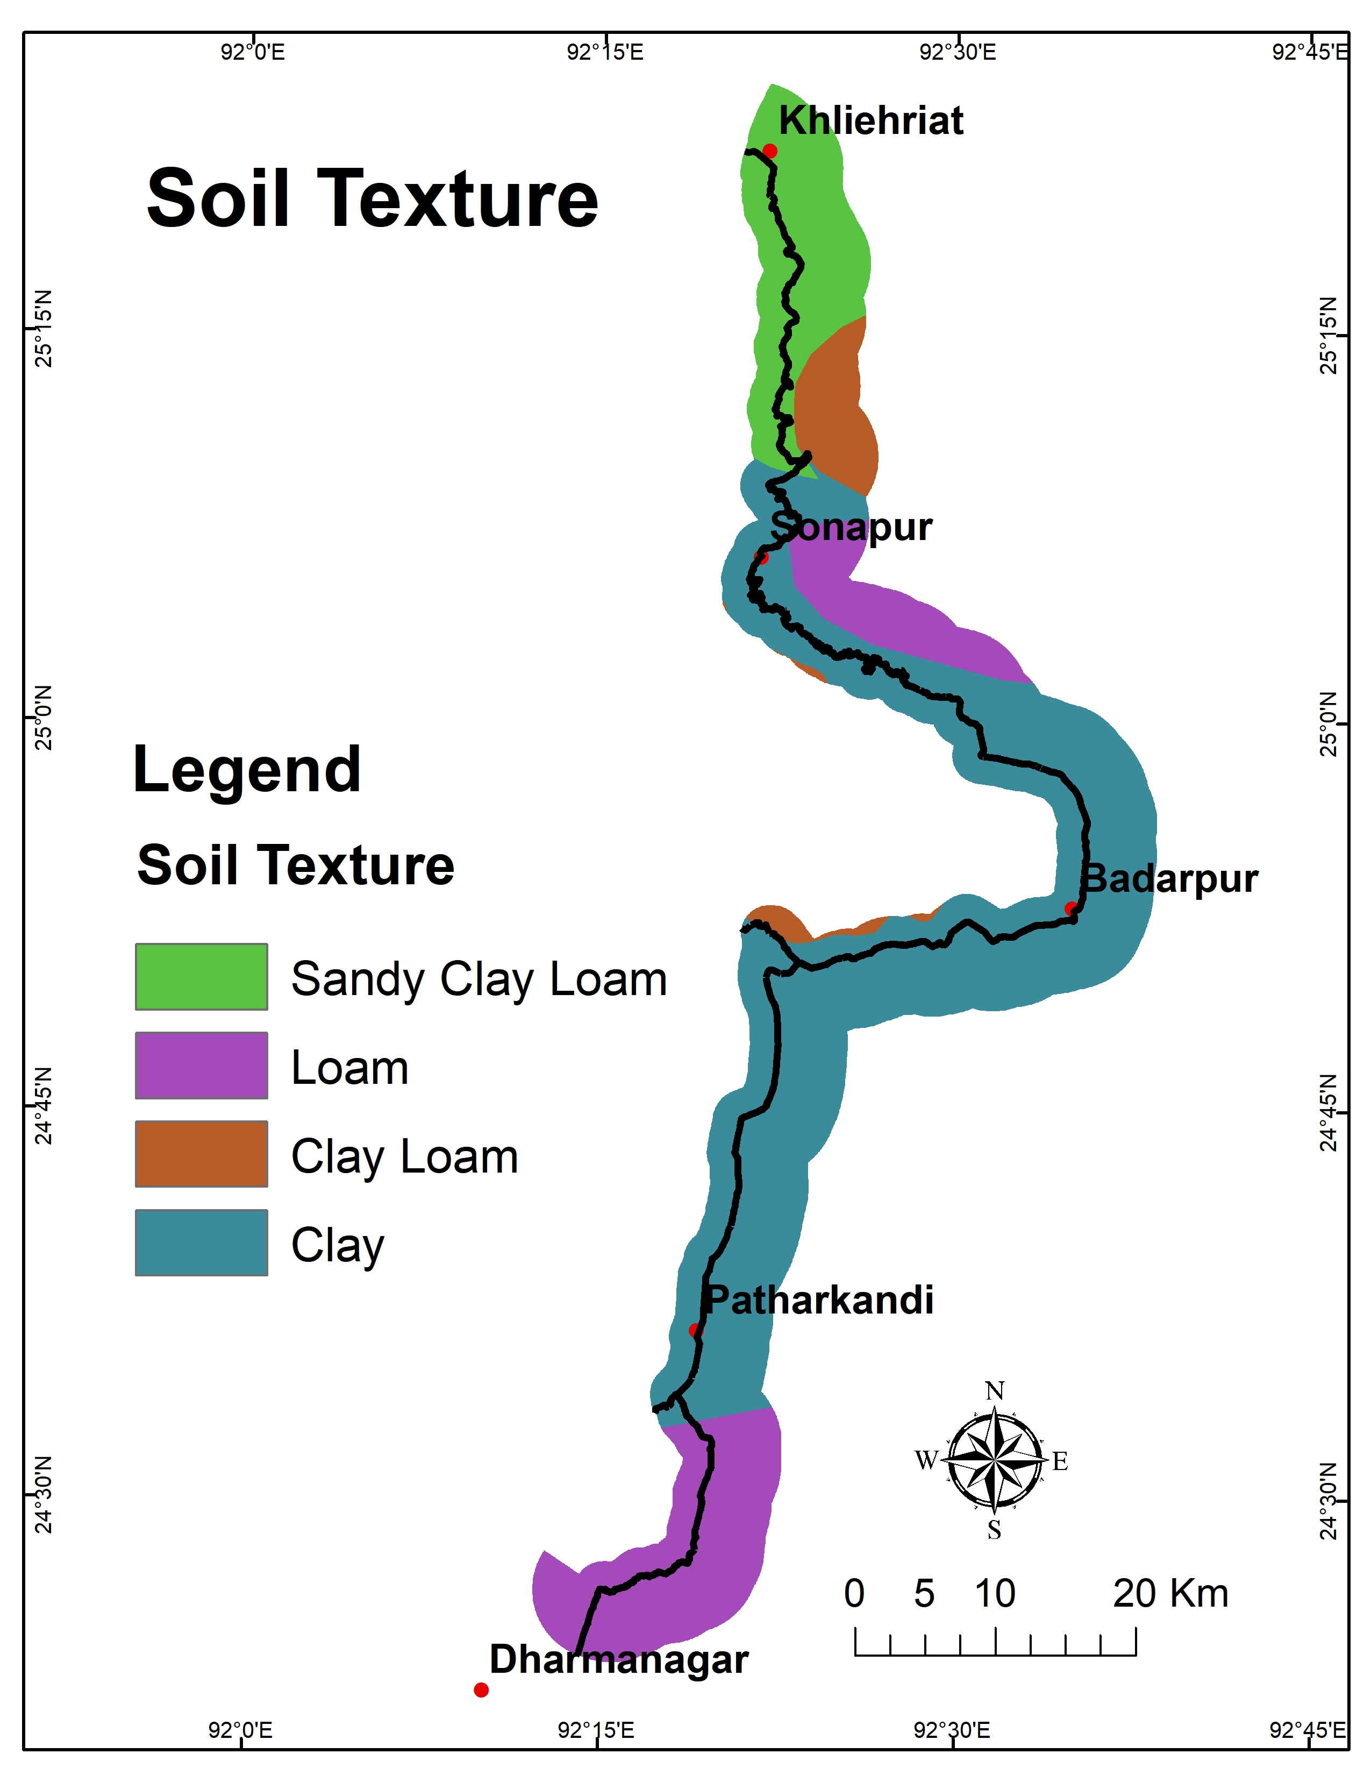
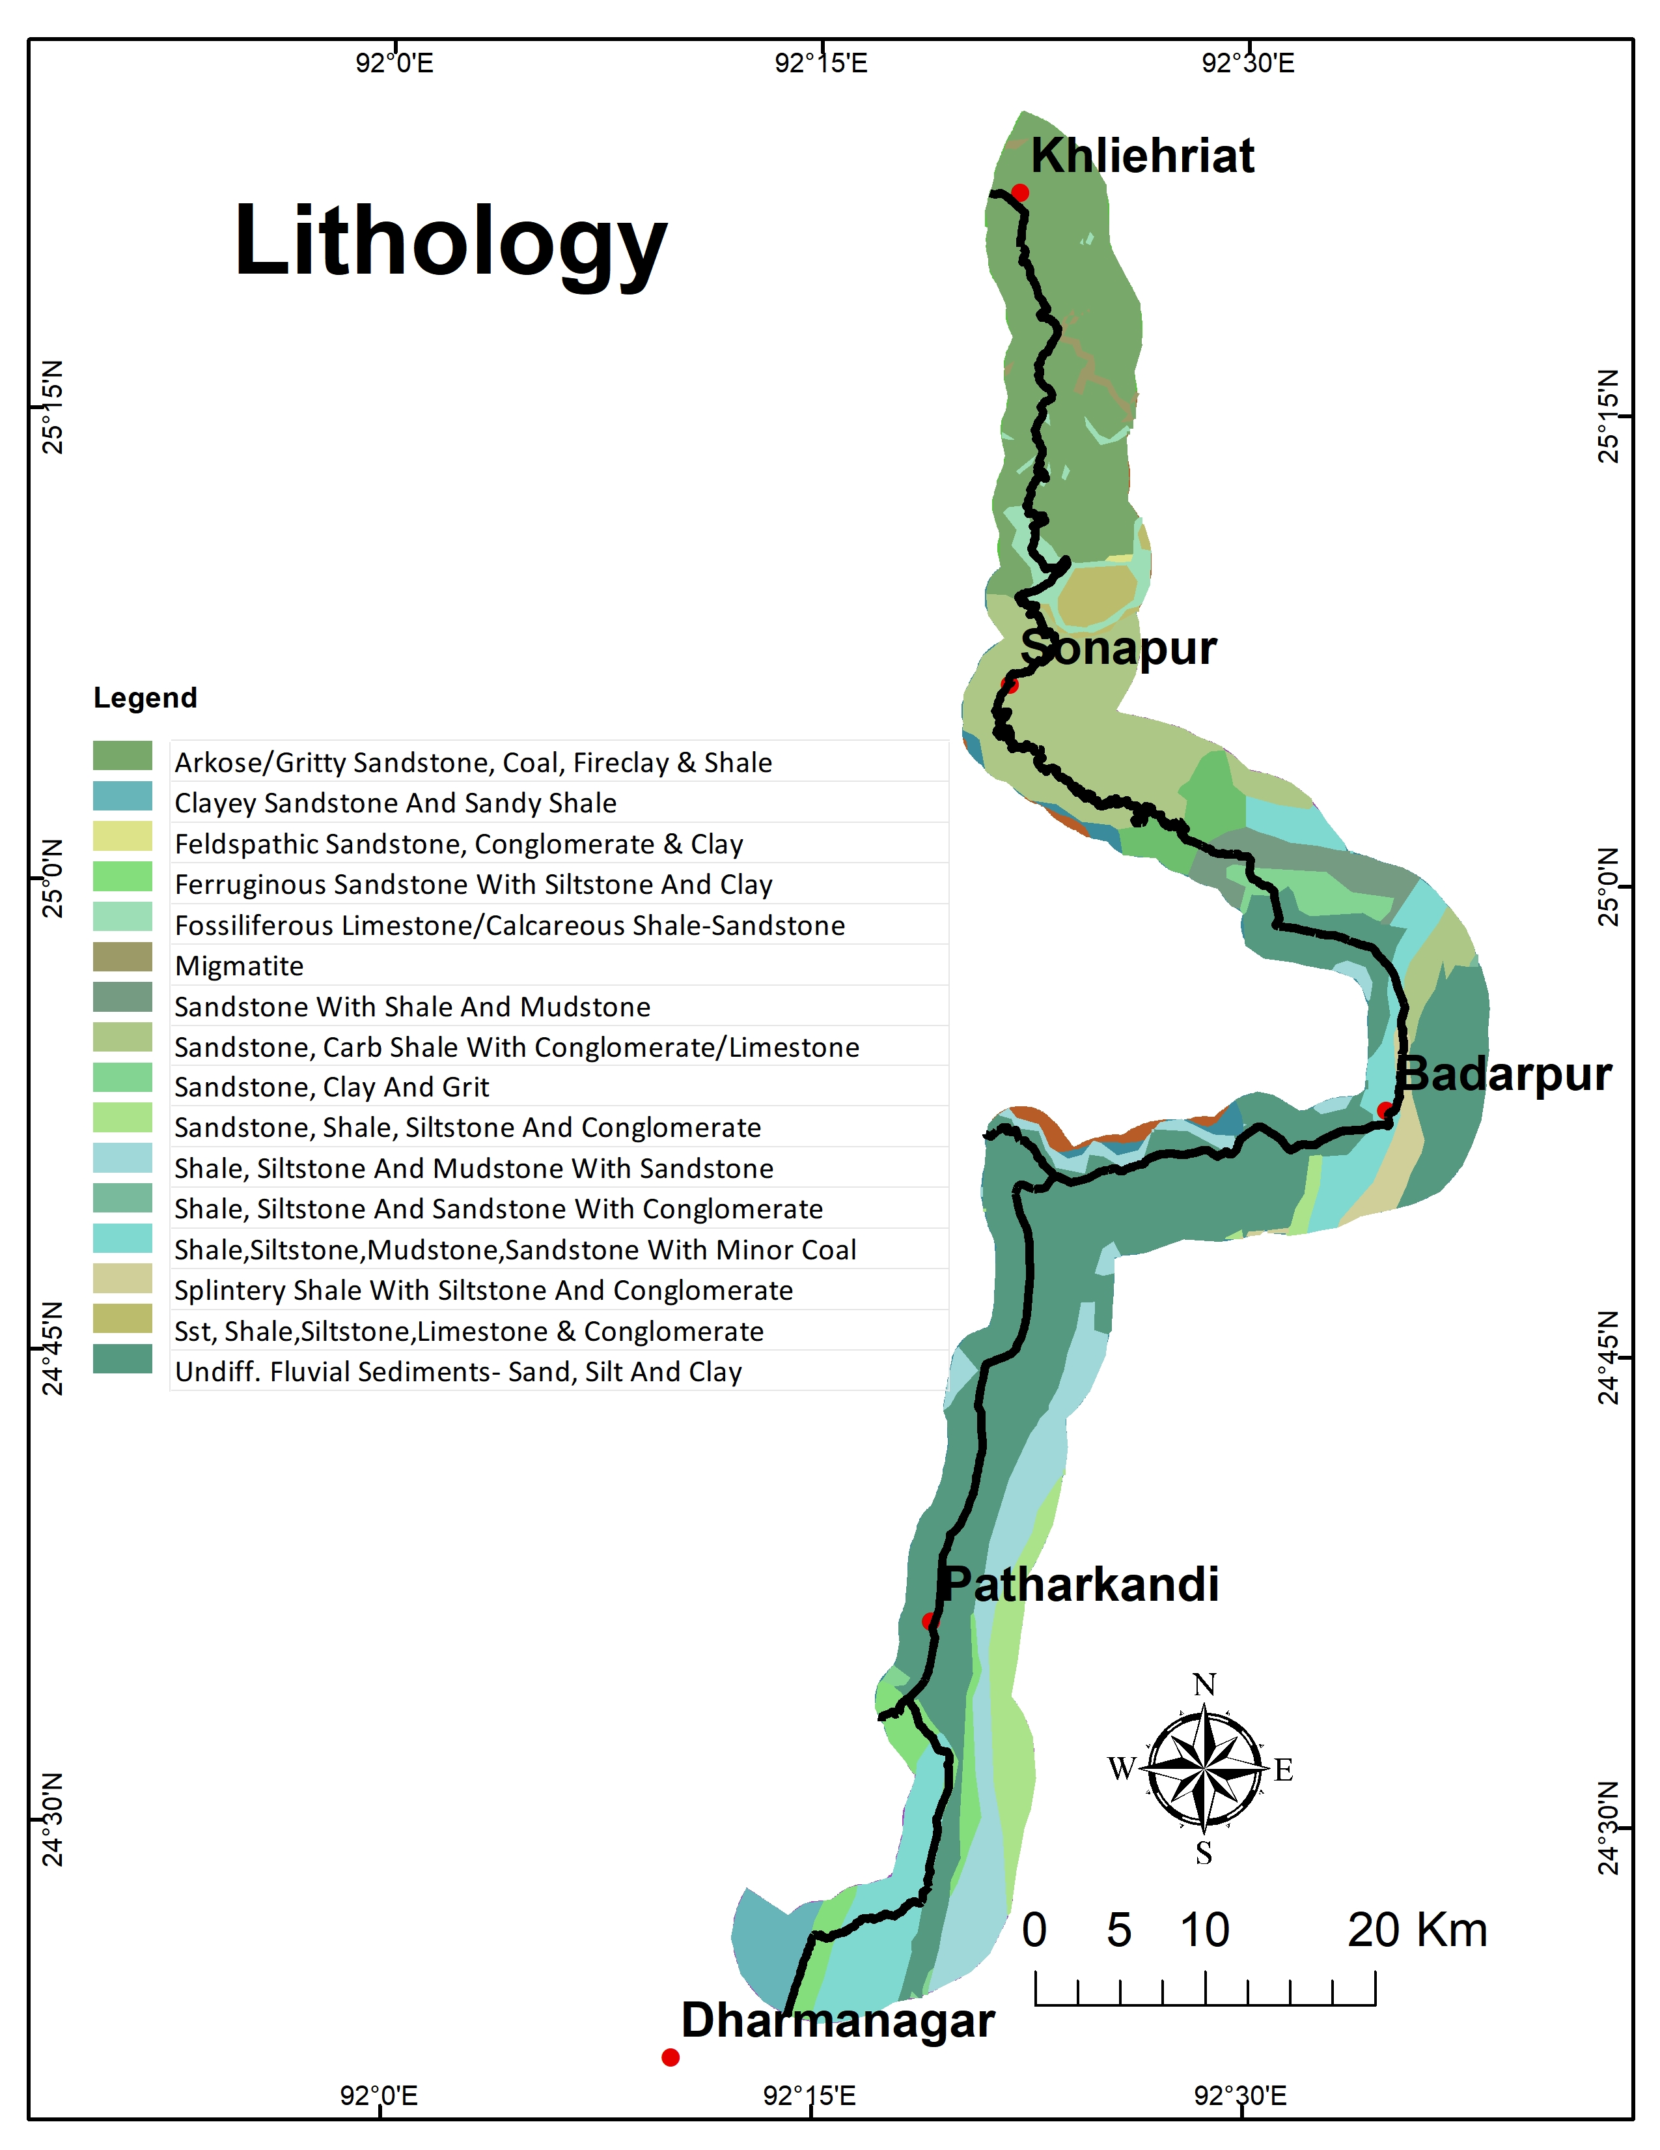
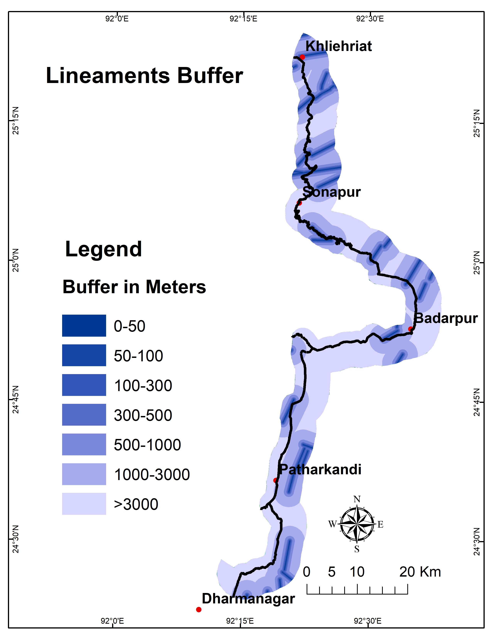
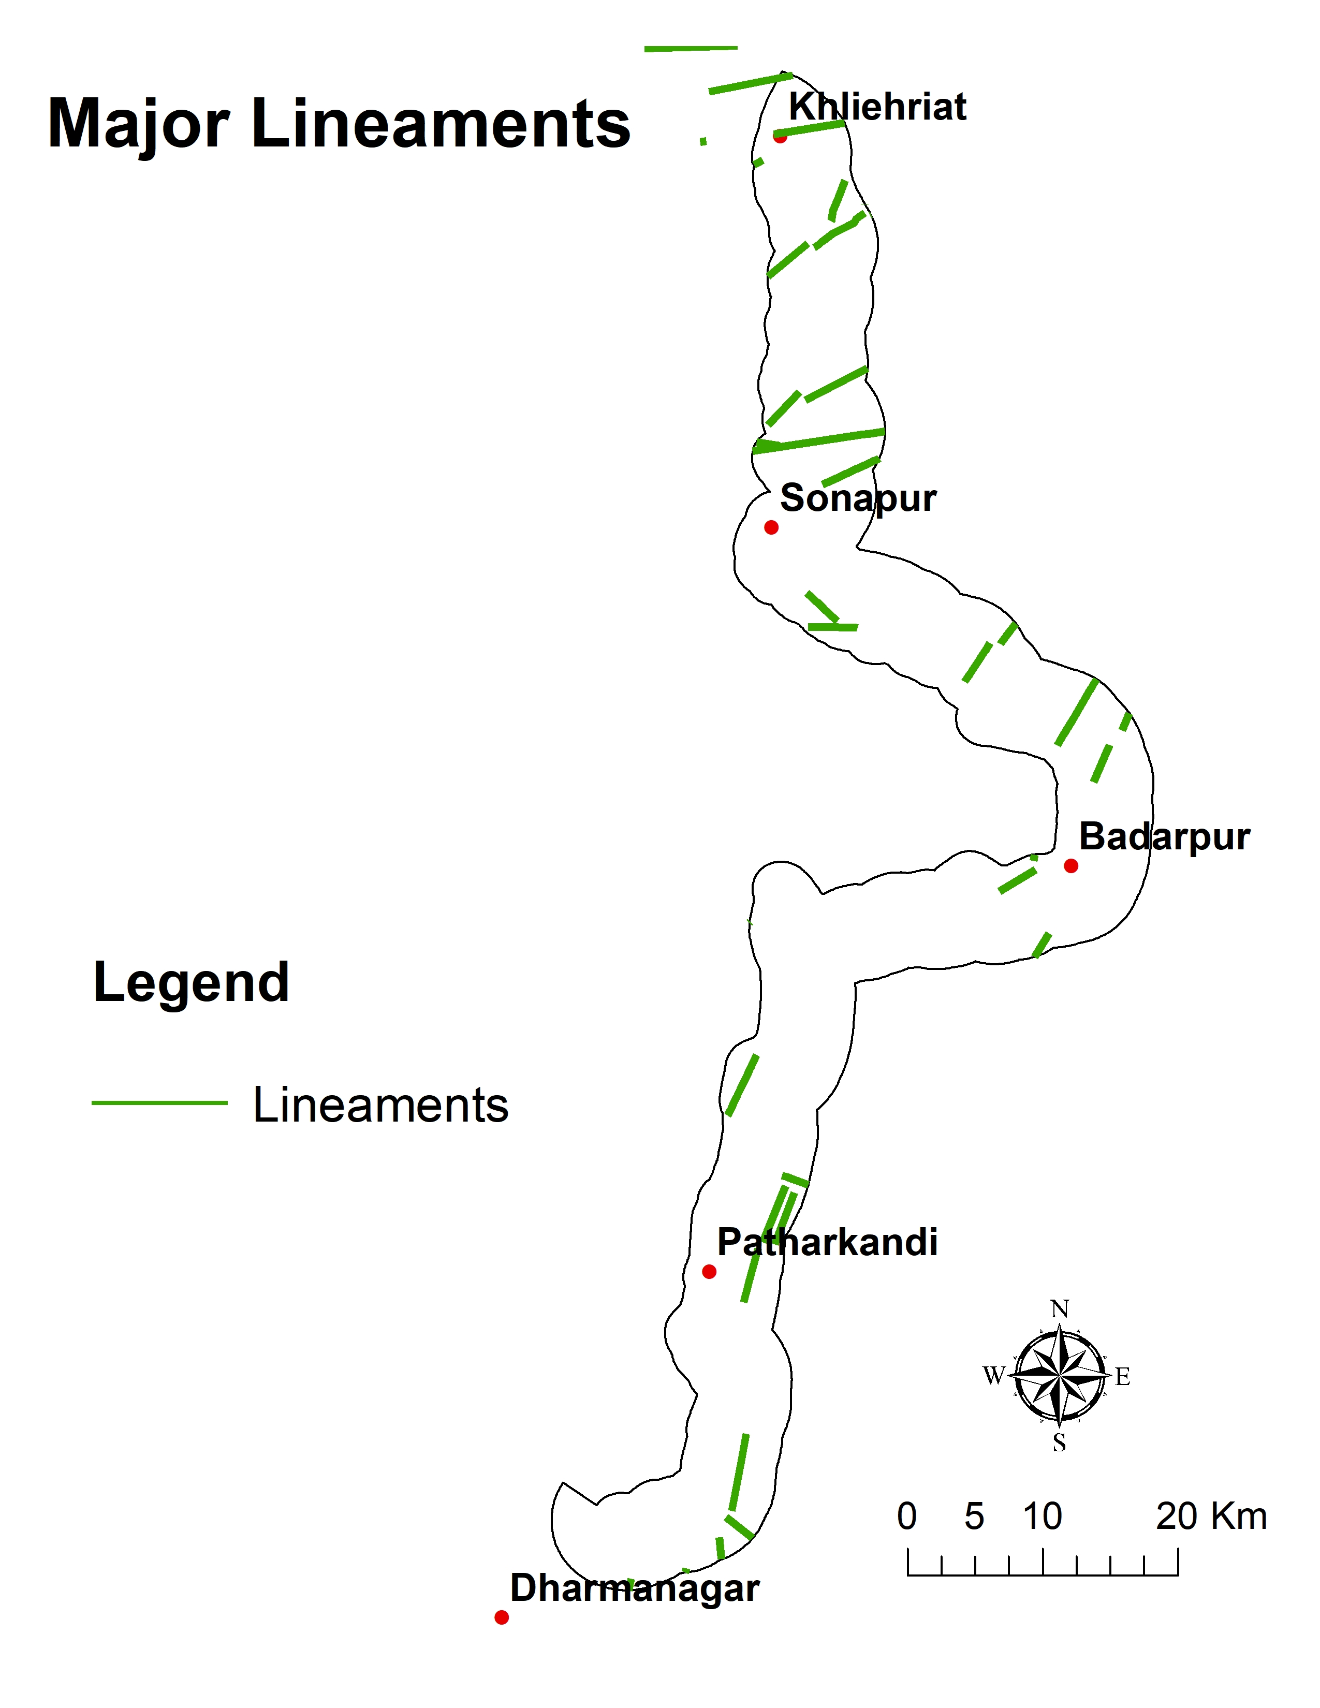
Criteria Layers:

Slide 13
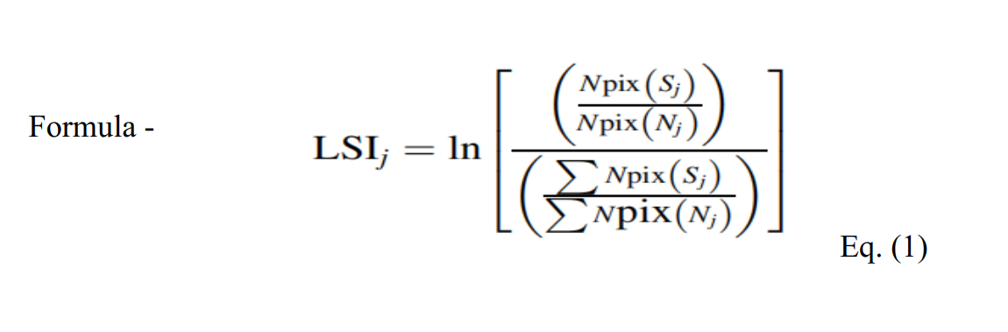
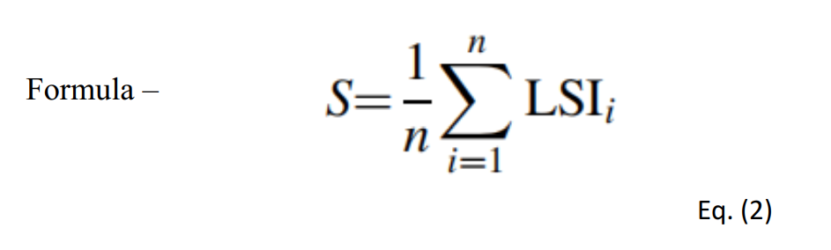
Landslide susceptibility index (LSI)
The LSI was proposed by Van Westen (1997) and simply defines the importance of a factor category on landslide occurrence according to spatial distribution of the pixels of the considered factors and the landslide pixels. This method calculates the LSI for each category of all factors that are selected for the this study. Thus, the LSI for the factor category j (LSIj) is defined as follows :
The overall susceptibility for each pixel is defined as:
LSI presents the relative susceptibility to landslide occurrence. If a category is highly correlated to landslides, the area associated with this category will have a high positive LSI value and vice versa.

Slide 14
Result:
Table 2. Calculation of LSI values for landslide related factors
Layer | Classes | Npix(Sj) | Npix (Nj) | LSI
Lithology | Arkose/Gritty Sandstone, Coal, Fireclay & Shale | 3 | 197252 | -1.56
 | Clayey Sandstone And Sandy Shale | 0 | 26658
 | Feldspathic Sandstone, Conglomerate & Clay | 0 | 620
 | Ferruginous Sandstone With Siltstone And Clay | 0 | 36891
 | Fossiliferous Limestone/Calcareous Shale-Sandstone | 2 | 23311 | 2.57
 | Migmatite | 0 | 5929
 | Sandstone With Shale And Mudstone | 5 | 31702 | 0.78
 | Sandstone, Carb Shale With Conglomerate/Limestone | 54 | 158343 | 1.55
 | Sandstone, Clay And Grit | 0 | 20252
 | Sandstone, Shale, Siltstone And Conglomerate | 0 | 46303
 | Shale, Siltstone And Mudstone With Sandstone | 0 | 101908
 | Shale, Siltstone And Sandstone With Conglomerate | 0 | 317
 | Shale,Siltstone,Mudstone,Sandstone With Minor Coal | 3 | 110893 | -0.98
 | Splintery Shale With Siltstone And Conglomerate | 0 | 19398
 | Sst, Shale,Siltstone,Limestone & Conglomerate | 0 | 16910
 | Undiff. Fluvial Sediments- Sand, Silt And Clay | 0 | 405151
Slope (in degree) | 0-5 | 2 | 644664 | -2.85
 | 5-10 | 5 | 275247 | -1.08
 | 10-15 | 7 | 121610 | 0.07
 | 15-25 | 15 | 133547 | 0.74
 | 25-45 | 37 | 72240 | 2.26
 | >45 | 1 | 2678 | 1.94

Slide 15
Lineaments Buffer (in m) | 0-50 | 4 | 10953 | 1.92
 | 50-100 | 3 | 11832 | 1.55
 | 100-300 | 6 | 51646 | 0.77
 | 300-500 | 4 | 50891 | 0.38
 | 500-1000 | 11 | 132640 | 0.44
 | 1000-3000 | 24 | 466137 | -0.04
 | >3000 | 15 | 525582 | -0.63
LULC | Agriciultural Land | 5 | 372836 | -1.40
 | Forest | 57 | 653583 | 0.47
 | Built Up Area | 2 | 66624 | -0.60
 | Waterbodies | 1 | 53587 | -1.07
 | Wastelands | 2 | 80907 | -0.79
road Buffer (in m) | 0-100 | 50 | 39839 | 3.15
 | 100-300 | 8 | 77115 | 0.66
 | 300-500 | 3 | 72100 | -0.25
 | 500-700 | 1 | 69635 | -1.32
 | 700-1000 | 1 | 107093 | -1.75
 | >1000 | 4 | 883127 | -2.47
Rainfall (mm) | 2,302.70 - 2,506.64 | 0 | 66598
 | 2,506.64 - 2,710.59 | 1 | 128818 | -1.93
 | 2,710.59 - 2,914.54 | 1 | 369558 | -2.99
 | 2,914.54 - 3,118.48 | 6 | 458270 | -1.41
 | 3,118.48 - 3,322.43 | 59 | 226461 | 1.58

Slide 16
Aspect | Flat | 0 | 10815
 | North | 2 | 87805 | -0.86
 | Northeast | 4 | 148825 | -0.69
 | East | 9 | 5233 | 3.46
 | Southeast | 10 | 180914 | 0.03
 | South | 16 | 187553 | 0.46
 | Southwest | 13 | 188601 | 0.25
 | West | 7 | 175550 | -0.30
 | Northwest | 6 | 174888 | -0.45
 | North |  | 84840
Soil | Sandy Clay Loam | 10 | 171014 | 0.06
 | Clay Loam | 2 | 69306 | -0.65
 | Loam | 7 | 269557 | -0.75
 | Clay | 50 | 740407 | 0.20
Table 3: Landslide susceptibility index (LSI) properties of the conditional factors
Factor Classes | Min | Max | Range | SD
Lithology | -1.56 | 2.57 | 4.13 | 1.72
Slope (in degree) | -2.85 | 2.26 | 5.11 | 1.92
Lineaments Buffer (in km) | -0.63 | 1.92 | 2.55 | 0.88
LULC | -1.40 | 0.47 | 1.87 | 0.71
Road Buffer (in km) | -2.47 | 3.15 | 5.62 | 2.03
Rainfall (mm) | -2.99 | 1.58 | 4.57 | 1.96
Aspect | -0.86 | 3.46 | 4.32 | 1.38
soil | -0.75 | 0.20 | 0.96 | 0.49

Slide 17
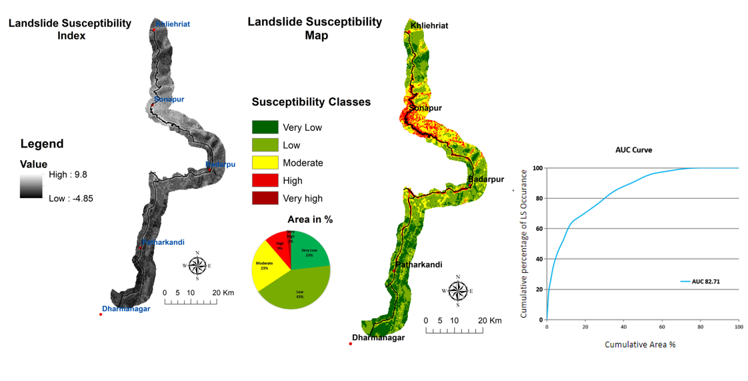
Result:

Slide 18
Results and Discussion:
The results of the statistical analysis are summarised in Tables 2(a), 2(b) and 3. The parameters with the strongest effect on landslide occurrence were aspect (LSImax = 3.46, LSIrange = 4.32, LSISD = 1.38), road buffer (LSImax = 3.15, LSIrange = 5.62, LSISD = 2.03), lithology (LSImax = 2.57, LSIrange = 4.13, LSISD = 1.72) and slope (LSImax = 2.26, LSIrange = 5.11, LSISD = 1.92). For these factors, the categories ‘‘east side’’, ‘‘0-100km road buffer’’ and ‘‘Fossiliferous Limestone/Calcareous Shale-Sandstone” and “25 – 450 slopes” are the most prone to landslide occurrences, with LSI values of 3.46, 3.15, 2.57 and 2.26, respectively.
It should be noted that the LSI value for the ‘‘Lineament buffer with 0-50 km cover was very high (LSI = 1.92). However, this category has very limited cover in the study area. The rainfall classes ‘‘2,710.59 - 2,914.54’’, ‘‘slope: 0-50’’ and ‘‘road buffer >1000 km’’ exhibited the lowest LSI values (-2.99, -2.86 and -2.47 respectively).
Soil type was the parameter with the weakest effect on landside occurrence (LSImax = 0.20, LSIrange = 0.96, LSISD = 0.49). Furthermore, low LSI values are performed by the categories ‘‘LULC: Agricultural land” (LSI=-1.40).

Slide 19
The outputs of the models were used in order to visualise the spatial distribution of the estimated LS in the study area. As mentioned before, in order to create comparable maps, LS was divided into five discrete classes: ‘‘Very Low’’, ‘‘Low’’, ‘‘Moderate’’, ‘‘High’’ and ‘‘Very High’’ LS according to ‘‘Natural Breaks (Jenks)’’ classification method. Figures 4(a) and 4(b) present the two final LS maps.
The output LS map from the statistical model shows that 9% and 2% of the study area are classified as ‘‘High’’ and ‘‘Very High’’ susceptibility classes, respectively. For the LSI model, the corresponding coverage percentages are 23% ,43% and 23%, respectively.

Slide 20
Conclusion:
Landslide susceptibility can be evaluated from different GIS-based methods. Especially in the last 20 years, many researchers attempted to solve deficiencies and difficulties in LS assessment.
The aim was to preparing an Landslide susceptibility map with having higher accuracy (Yilmaz 2009a, b, 2010a, b). Overall the study has highlighted that remote sensing techniques greatly aid in the investigations of landslides.
LSI can help in aiding in informed decision-making for hazard mitigation and infrastructure development.

Slide 21
Reference:
Amit Bera1 · Bhabani Prasad Mukhopadhyay1 · Debasish Das2 Landslide hazard zonation mapping using multi-criteria analysis with the help of GIS techniques: a case study from Eastern Himalayas, Namchi, South Sikkim
Christos Polykretis, Maria Ferentinou, Christos (2014) A comparative study of landslide susceptibility mapping using landslide susceptibility index and artificial neural networks in the Krios River and Krathis River catchments (northern Peloponnesus, Greece) Chalkias Received: 26 November 2013 / Accepted: 2 April 2014 / Published online: 27 April 2014 Ó Springer-Verlag Berlin Heidelberg 2014
Meghanadh Devara, Vishwajith M V, V K Maurya and Ramji Dwivedi Landslide susceptibility mapping using machine learning algorithm
ROHAN KUMAR* and R. ANBALAGAN Landslide Susceptibility Mapping Using Analytical Hierarchy Process (AHP) in Tehri Reservoir Rim Region, Uttarakhand
S. Samansiri, P.K. Champati ray1. S.K. Srivastav1 and V. Thitisawam2 Remote Sensing and GIS based method for Landslide Susceptibility Mapping along Silchar-Shillong Highway, Northeast India

